Slide 1

Research Paper Assignment
M5: Mastering Page Migration and Memory Management for CXL-based Tiered Memory Systems
Topic: Memory Management Published in: ASPLOS 2025
Presented By: Lab Group 1
Kavya Kumar Agarwal – 230101053 Pratyush Kumar Swain – 230101079
Ritvij Gopal – 230101085
Parv Goyal - 230101124
Notes:
DFD

Slide 2

CONTENTS
INTRODUCTION
CXL MEMORY AND DEVICE TYPES
CXL CONTROLLER ARCHITECTURE
CONTRIBUTIONS
CPU-DRIVEN SOLUTIONS
CXL-DRIVEN PAGE
USEFULNESS AND PERFORMANCE COST
M5
EVALUATION SETUP AND EVALUATION
DISCUSSION
RELATED WORKS
CONCLUSION

Slide 3
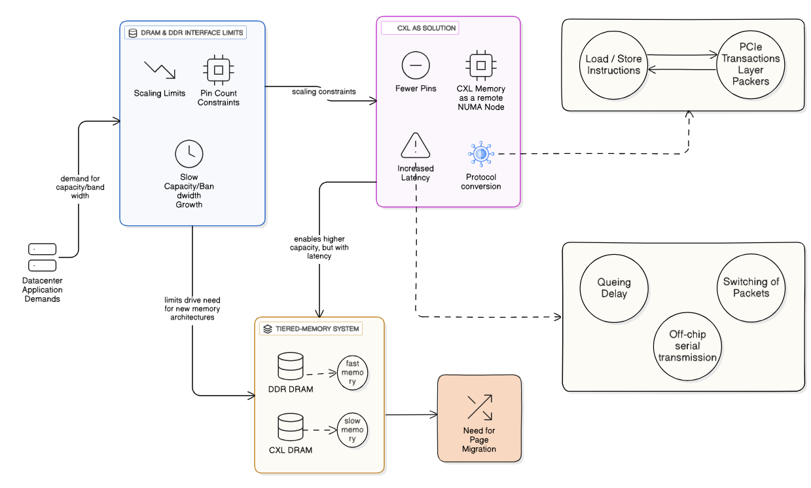
INTRODUCTION
Notes:
KAVYA

Slide 4
INTRODUCTION
Notes:
KAVYA

Slide 5
INTRODUCTION
Notes:
KAVYA

Slide 6
INTRODUCTION
Notes:
KAVYA

Slide 7
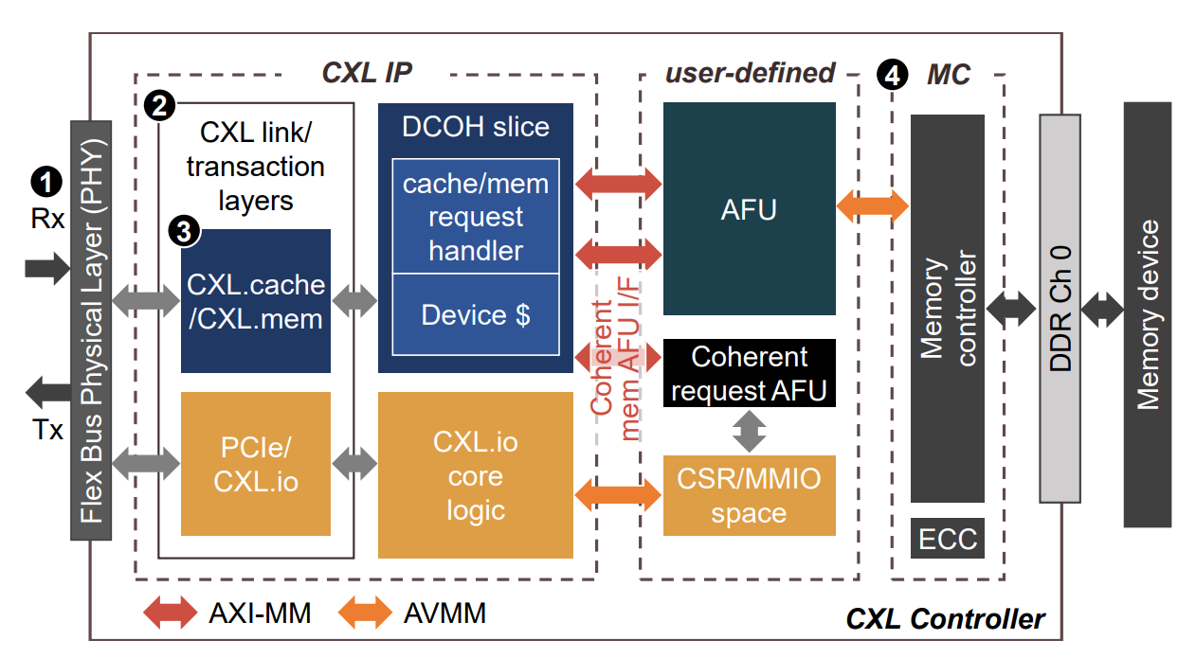
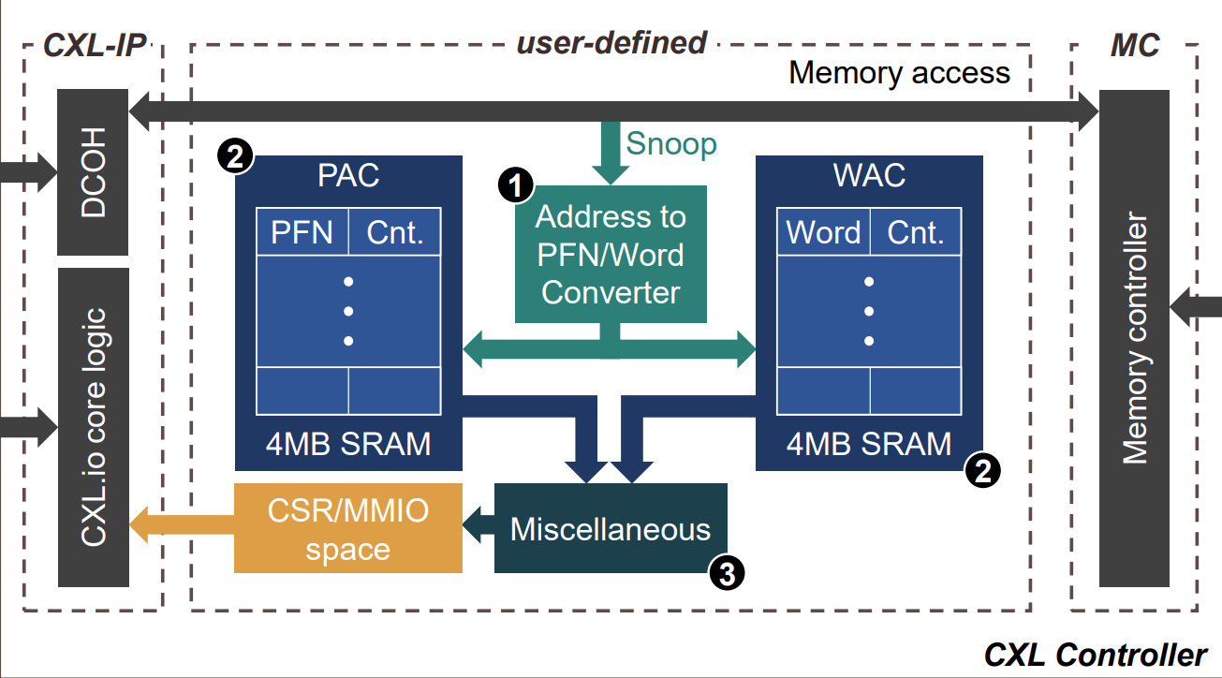
CONTRIBUTIONS OF THE RESEARCH PAPER
A CXL-driven hot-page and hot-word profiling solution
CPU-driven page-migration solutions considered harmful
A platform for developing CXL-driven page-migration solutions
Page Access Counter (PAC) and Word Access Counter (WAC), implemented in an FPGA-based CXL device.
Count the number of accesses to every 4KB page and 64B word
Provide a more precise and transparent profiling capability
CPU-driven page-migration solutions (ANB and DAMON) often identify warm pages in popular memory-intensive applications.
These page-migration solutions often migrate sparse pages.
Performance overhead of identifying hot pages and migrating them is high.
M5 consists of the following two key components: (1) Hot-Page Tracker (HPT) and Hot-Word Tracker (HWT) and (2) M5-manager.
HPT and HWT cost effectively track the top-𝐾 hot pages and hot words, respectively.
M5-manager provides users with software interfaces for the synergistic use of HPT and HWT.
Notes:
PARV

Slide 8
CONTRIBUTIONS OF THE RESEARCH PAPER
A CXL-driven hot-page and hot-word profiling solution
CPU-driven page-migration solutions considered harmful
A platform for developing CXL-driven page-migration solutions
Page Access Counter (PAC) and Word Access Counter (WAC), implemented in an FPGA-based CXL device.
Count the number of accesses to every 4KB page and 64B word
Provide a more precise and transparent profiling capability
CPU-driven page-migration solutions (ANB and DAMON) often identify warm pages in popular memory-intensive applications.
These page-migration solutions often migrate sparse pages.
Performance overhead of identifying hot pages and migrating them is high.
M5 consists of the following two key components: (1) Hot-Page Tracker (HPT) and Hot-Word Tracker (HWT) and (2) M5-manager.
HPT and HWT cost effectively track the top-𝐾 hot pages and hot words, respectively.
M5-manager provides users with software interfaces for the synergistic use of HPT and HWT.
Notes:
PARV

Slide 9
CONTRIBUTIONS OF THE RESEARCH PAPER
A CXL-driven hot-page and hot-word profiling solution
CPU-driven page-migration solutions considered harmful
A platform for developing CXL-driven page-migration solutions
Page Access Counter (PAC) and Word Access Counter (WAC), implemented in an FPGA-based CXL device.
Count the number of accesses to every 4KB page and 64B word
Provide a more precise and transparent profiling capability
CPU-driven page-migration solutions (ANB and DAMON) often identify warm pages in popular memory-intensive applications.
These page-migration solutions often migrate sparse pages.
Performance overhead of identifying hot pages and migrating them is high.
M5 consists of the following two key components: (1) Hot-Page Tracker (HPT) and Hot-Word Tracker (HWT) and (2) M5-manager.
HPT and HWT cost effectively track the top-𝐾 hot pages and hot words, respectively.
M5-manager provides users with software interfaces for the synergistic use of HPT and HWT.
Notes:
PARV

Slide 10
CONTRIBUTIONS OF THE RESEARCH PAPER
A CXL-driven hot-page and hot-word profiling solution
CPU-driven page-migration solutions considered harmful
A platform for developing CXL-driven page-migration solutions
Page Access Counter (PAC) and Word Access Counter (WAC), implemented in an FPGA-based CXL device.
Count the number of accesses to every 4KB page and 64B word
Provide a more precise and transparent profiling capability
CPU-driven page-migration solutions (ANB and DAMON) often identify warm pages in popular memory-intensive applications.
These page-migration solutions often migrate sparse pages.
Performance overhead of identifying hot pages and migrating them is high.
M5 consists of the following two key components: (1) Hot-Page Tracker (HPT) and Hot-Word Tracker (HWT) and (2) M5-manager.
HPT and HWT cost effectively track the top-𝐾 hot pages and hot words, respectively.
M5-manager provides users with software interfaces for the synergistic use of HPT and HWT.

Slide 11
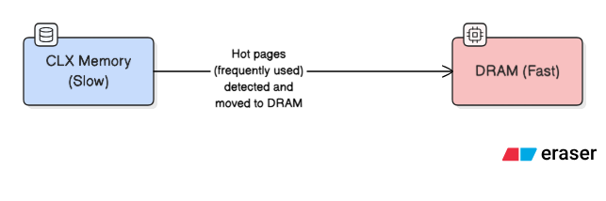
CPU-DRIVEN PAGE MIGRATION SOLUTIONS
A CXL-driven hot-page and hot-word profiling solution
CPU-driven page-migration solutions considered harmful
A platform for developing CXL-driven page-migration solutions
Page Access Counter (PAC) and Word Access Counter (WAC), implemented in an FPGA-based CXL device.
Count the number of accesses to every 4KB page and 64B word
Provide a more precise and transparent profiling capability
CPU-driven page-migration solutions (ANB and DAMON) often identify warm pages in popular memory-intensive applications.
These page-migration solutions often migrate sparse pages.
Performance overhead of identifying hot pages and migrating them is high.
M5 consists of the following two key components: (1) Hot-Page Tracker (HPT) and Hot-Word Tracker (HWT) and (2) M5-manager.
HPT and HWT cost effectively track the top-𝐾 hot pages and hot words, respectively.
M5-manager provides users with software interfaces for the synergistic use of HPT and HWT.

Slide 12
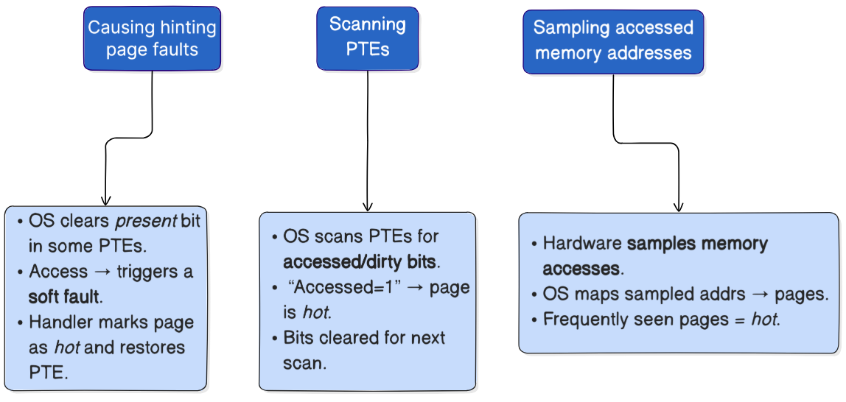
THE GOAL: IDENTIFY HOT PAGES

Slide 13
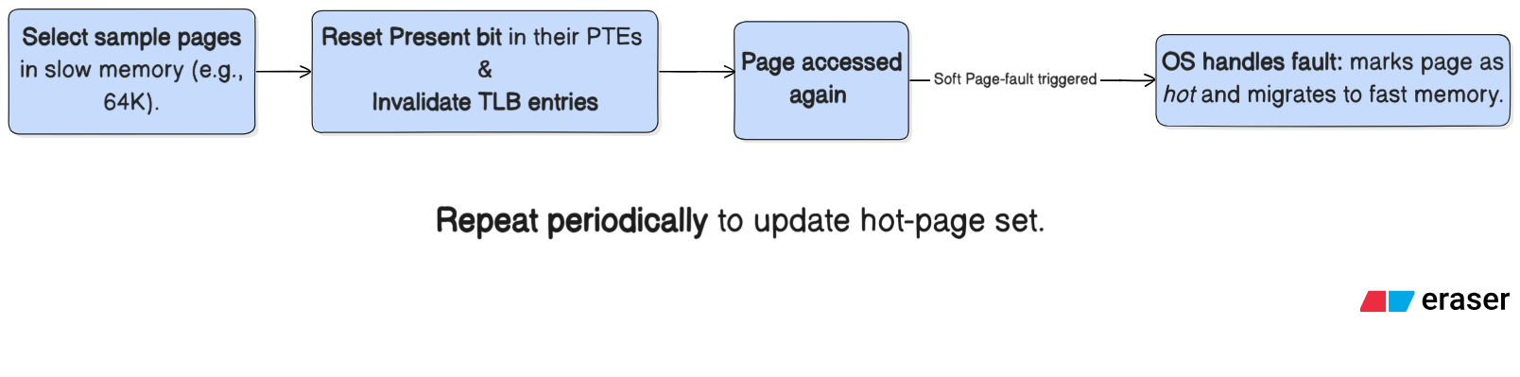
SOLUTION 1: HINTING PAGE FAULTS
Problems
High CPU overhead (PTE access + TLB shootdowns + page faults).
Frequent interrupts slow down latency-sensitive apps (e.g., Redis).
Causes false positives if page accessed only once after hinting.
Conclusion
Effectively identifies recently accessed (hot) pages.
But incurs high CPU and TLB overhead, making it inefficient for large-scale or latency-sensitive workloads.
Best suited for batch or throughput-oriented applications, not for real-time systems like Redis.
Example
TPP (Transparent Page Placement) uses this approach.

Slide 14
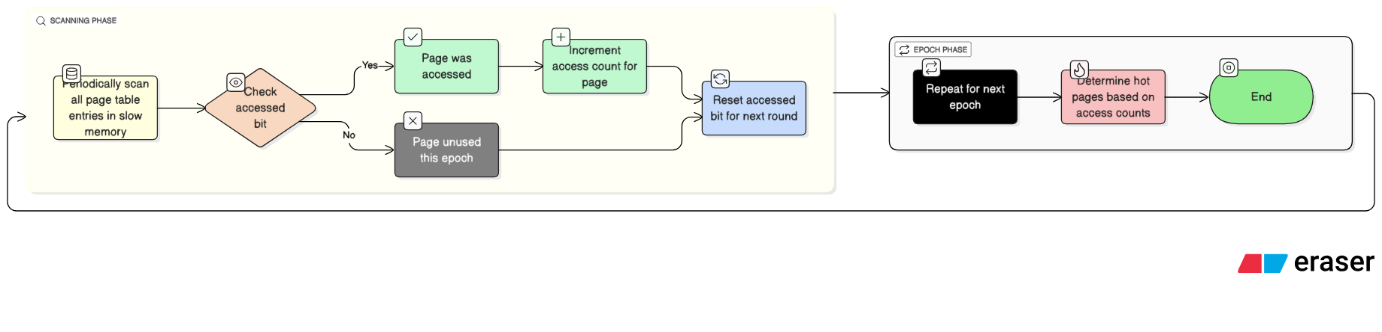
SOLUTION 2: SCANNING PTES
Problems
High CPU cost (must scan all PTEs each epoch)
Accessed bit = only 1-bit info → can’t track multiple accesses
TLB entries invalidated passively (depends on context switches/conflicts)
Slow for large memory workloads
Conclusion
Simple and hardware-supported method
Inefficient for large systems; coarse-grained tracking
Example
Used in early NUMA-aware page migration systems like AutoNUMA (Linux Kernel)
​

Slide 15
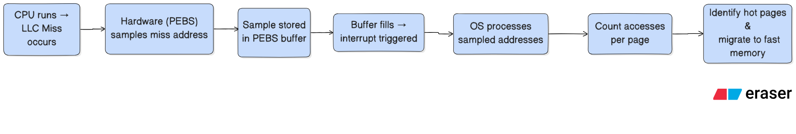
SOLUTION 3: SAMPLING ACCESSED MEMORY ADDRESSES
Problems
Does not capture all accesses (sampling-based → incomplete).
Frequent interrupts increase CPU overhead at high sampling rates.
Limited hardware support (e.g., Intel PEBS can’t sample CXL memory).
Conclusions
Provides approximate hot-page detection with moderate accuracy.
Lower CPU cost than full PTE scanning, but less precise.
Good tradeoff for large-memory workloads where full tracking is expensive.
Examples
Intel Processor Event-Based Sampling (PEBS).
Used in memory-tiering systems to monitor access frequency.

Slide 16
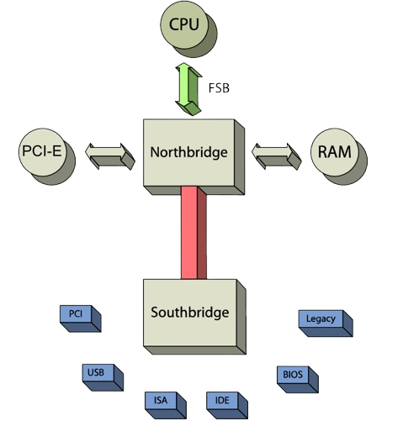
NORTH/SOUTH BRIDGE
Notes:
KAVYA

Slide 17
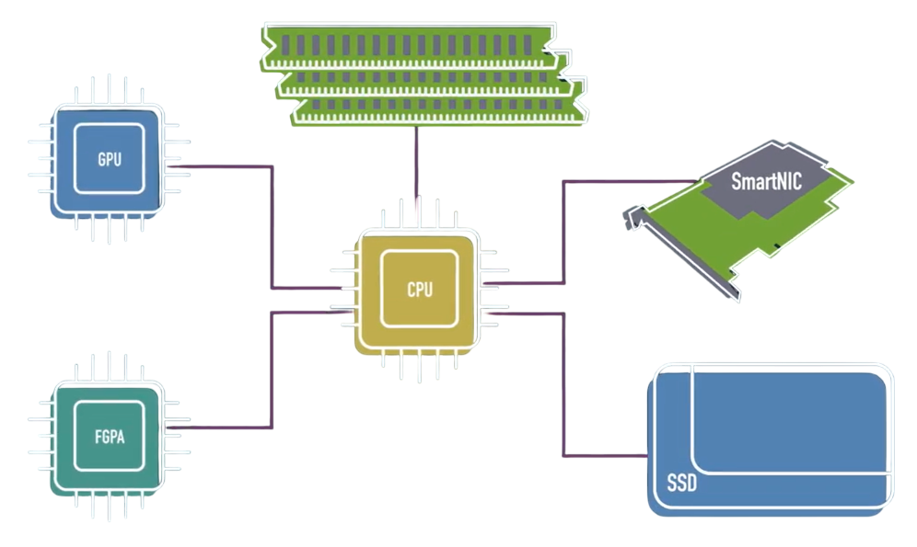

CXL MEMORY
SmartNICs
Memory Expanders
Accelerators
SSD
Notes:
KAVYA

Slide 18
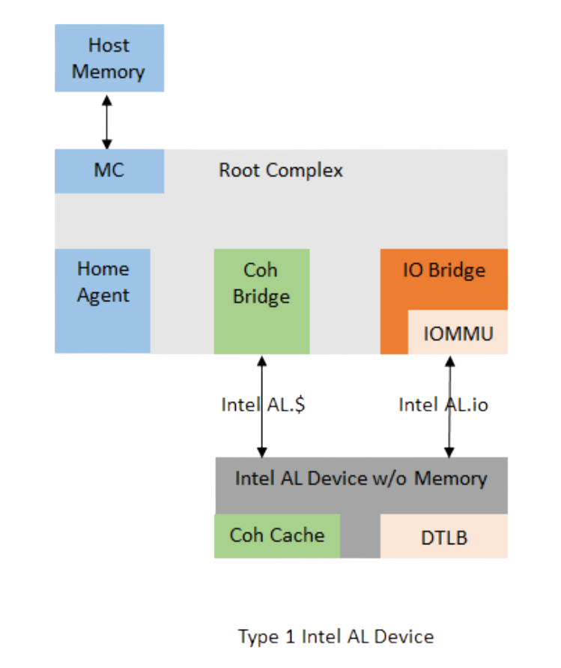
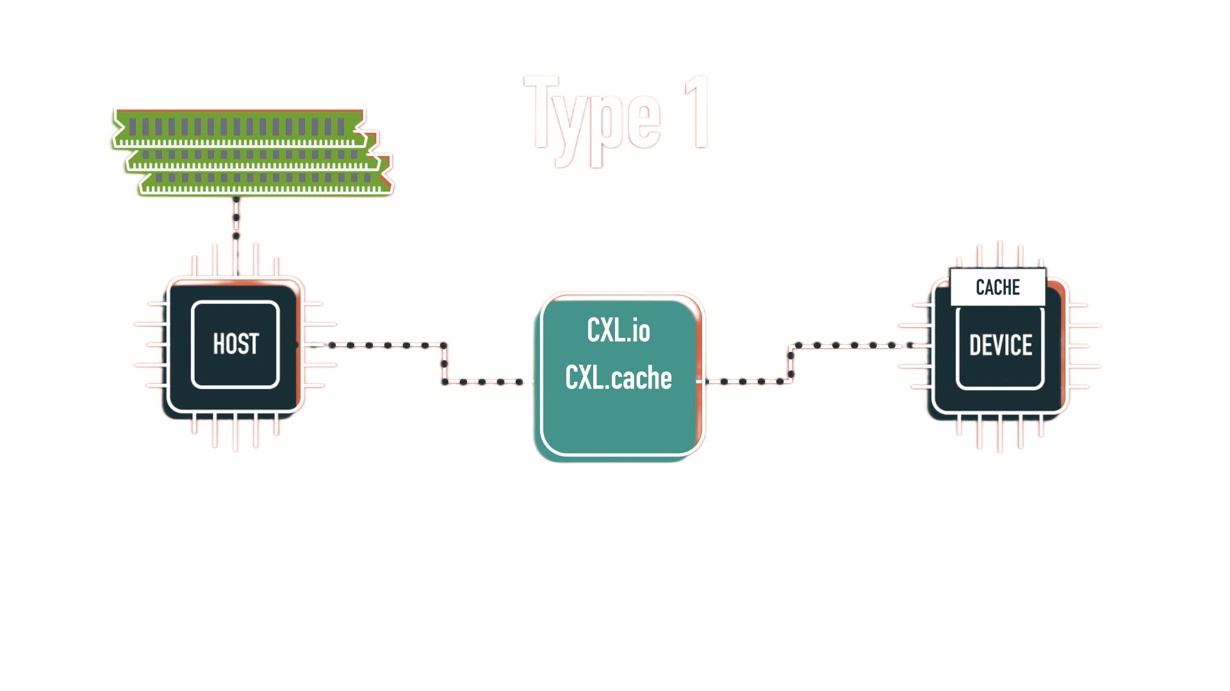
DEVICE TYPES: 01
SmartNICs
Memory Expanders
Accelerators
SSD
Notes:
KAVYA

Slide 19
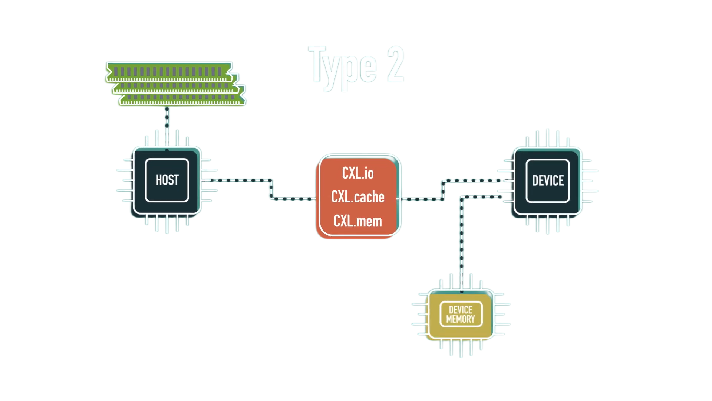
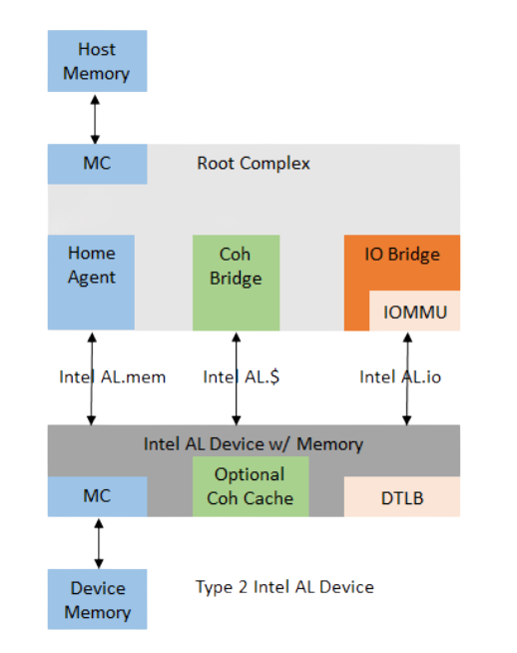
DEVICE TYPES: 02
SmartNICs
Memory Expanders
Accelerators
SSD
Notes:
KAVYA

Slide 20
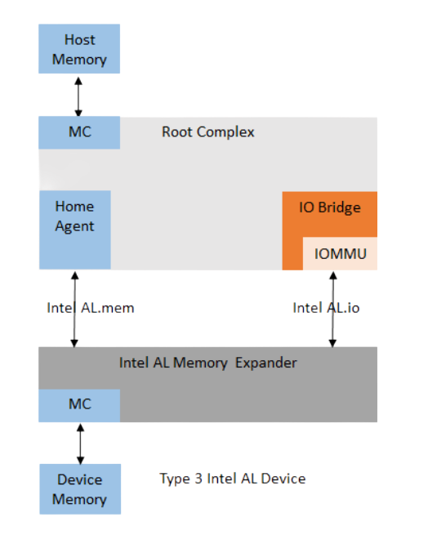
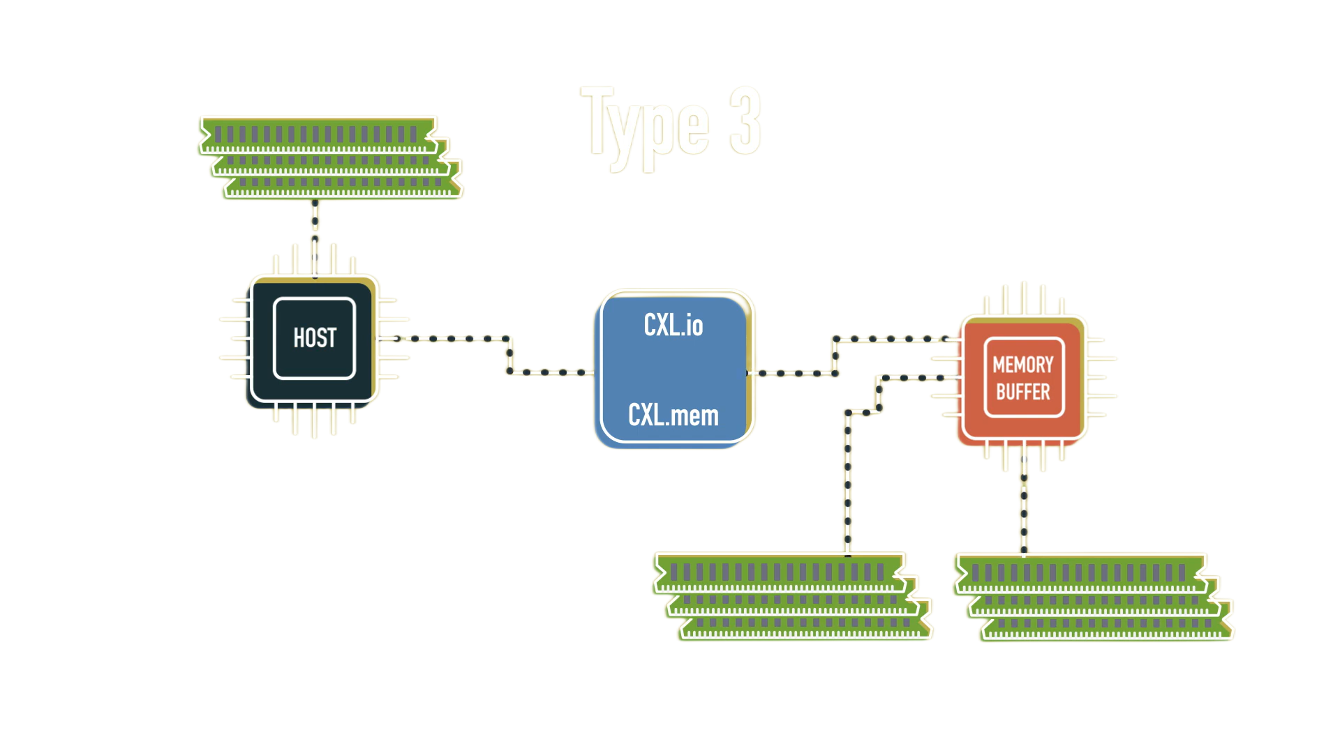
DEVICE TYPES: 03
SmartNICs
Memory Expanders
Accelerators
SSD
Notes:
KAVYA

Slide 21
CXL CONTROLLER ARCHITECTURE
Host Integrated Memory controller (IMC)
CXL CONTROLLER
CXL DRAM
Notes:
KVAY

Slide 22
CXL CONTROLLER ARCHITECTURE
Host Integrated Memory controller (IMC)
CXL DRAM
Notes:
KVAY

Slide 23
CXL CONTROLLER ARCHITECTURE

Slide 24
CXL CONTROLLER ARCHITECTURE

Slide 25
CXL CONTROLLER ARCHITECTURE

Slide 26
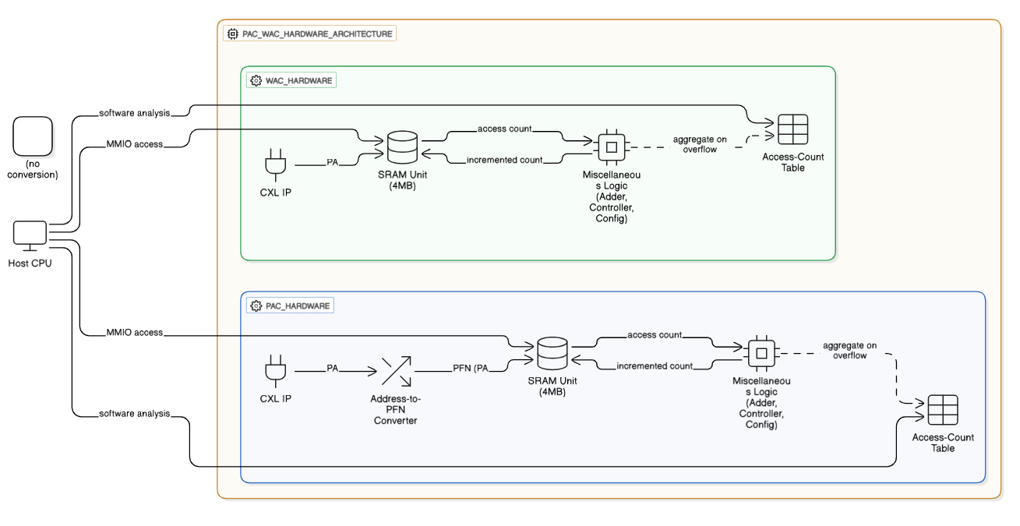
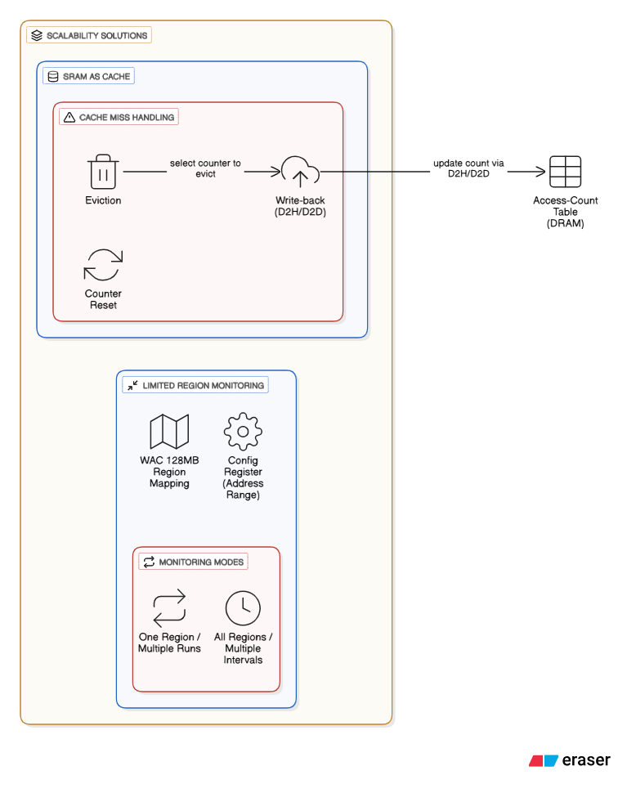
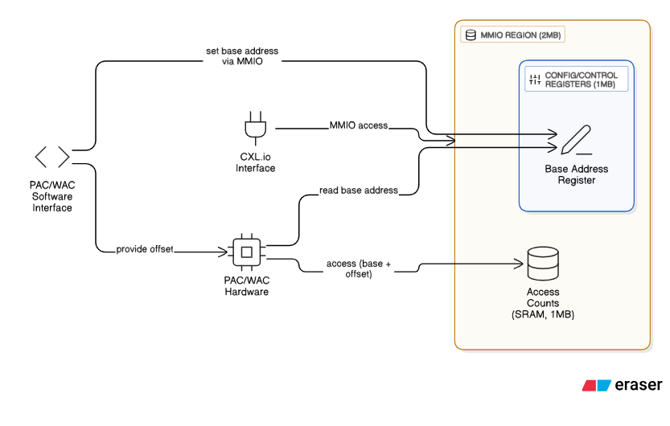
CXL-DRIVEN PAGE AND WORD ACCESS COUNTING: HARDWARE
Problems
Does not capture all accesses (sampling-based → incomplete).
Frequent interrupts increase CPU overhead at high sampling rates.
Limited hardware support (e.g., Intel PEBS can’t sample CXL memory).
Conclusions
Provides approximate hot-page detection with moderate accuracy.
Lower CPU cost than full PTE scanning, but less precise.
Good tradeoff for large-memory workloads where full tracking is expensive.
Examples
Intel Processor Event-Based Sampling (PEBS).
Used in memory-tiering systems to monitor access frequency.

Slide 27
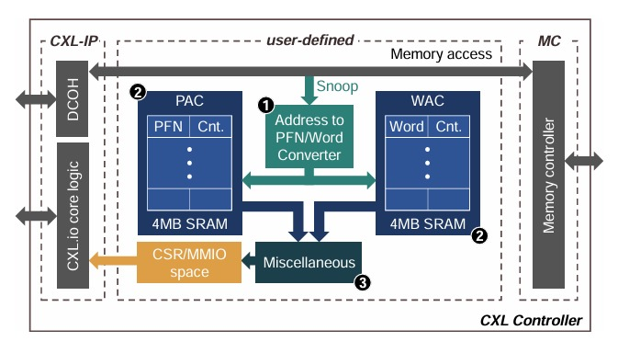
CXL CONTROLLER ARCHITECTURE
Host Integrated Memory controller (IMC)
CXL DRAM
Notes:
KVAY

Slide 28
CXL-DRIVEN PAGE AND WORD ACCESS COUNTING: SOFTWARE
Problems
Does not capture all accesses (sampling-based → incomplete).
Frequent interrupts increase CPU overhead at high sampling rates.
Limited hardware support (e.g., Intel PEBS can’t sample CXL memory).
Conclusions
Provides approximate hot-page detection with moderate accuracy.
Lower CPU cost than full PTE scanning, but less precise.
Good tradeoff for large-memory workloads where full tracking is expensive.
Examples
Intel Processor Event-Based Sampling (PEBS).
Used in memory-tiering systems to monitor access frequency.

Slide 29
CXL-DRIVEN PAGE AND WORD ACCESS COUNTING: SCALABILITY
Problems
Does not capture all accesses (sampling-based → incomplete).
Frequent interrupts increase CPU overhead at high sampling rates.
Limited hardware support (e.g., Intel PEBS can’t sample CXL memory).
Conclusions
Provides approximate hot-page detection with moderate accuracy.
Lower CPU cost than full PTE scanning, but less precise.
Good tradeoff for large-memory workloads where full tracking is expensive.
Examples
Intel Processor Event-Based Sampling (PEBS).
Used in memory-tiering systems to monitor access frequency.

Slide 30
CXL-DRIVEN PAGE AND WORD ACCESS COUNTING: SCALABILITY
Problems
Does not capture all accesses (sampling-based → incomplete).
Frequent interrupts increase CPU overhead at high sampling rates.
Limited hardware support (e.g., Intel PEBS can’t sample CXL memory).
Conclusions
Provides approximate hot-page detection with moderate accuracy.
Lower CPU cost than full PTE scanning, but less precise.
Good tradeoff for large-memory workloads where full tracking is expensive.
Examples
Intel Processor Event-Based Sampling (PEBS).
Used in memory-tiering systems to monitor access frequency.

Slide 31
CXL-DRIVEN PAGE AND WORD ACCESS COUNTING: SCALABILITY
Problems
Does not capture all accesses (sampling-based → incomplete).
Frequent interrupts increase CPU overhead at high sampling rates.
Limited hardware support (e.g., Intel PEBS can’t sample CXL memory).
Conclusions
Provides approximate hot-page detection with moderate accuracy.
Lower CPU cost than full PTE scanning, but less precise.
Good tradeoff for large-memory workloads where full tracking is expensive.
Examples
Intel Processor Event-Based Sampling (PEBS).
Used in memory-tiering systems to monitor access frequency.

Slide 32
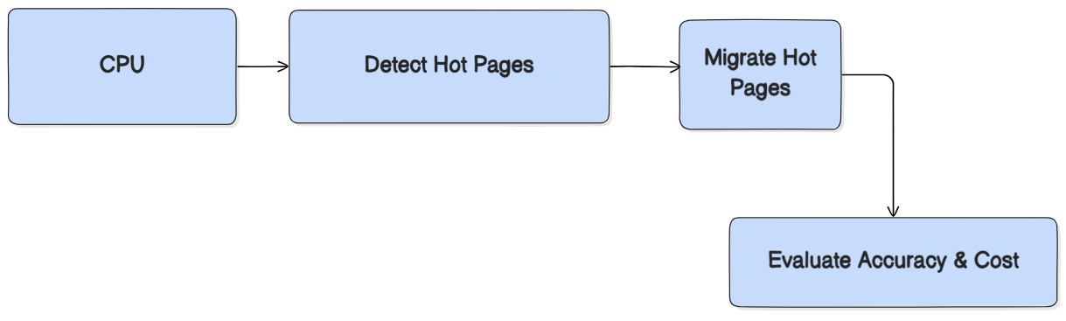
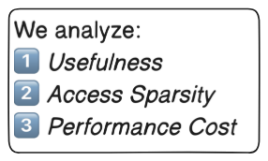
USEFULNESS & COST OF CPU-DRIVEN PAGE MIGRATION SOLUTIONS
Evaluate how accurately and efficiently CPU-driven page-migration solutions identify “hot” pages in memory using:
🔹 PAC (Page Access Counter): Measures the true number of accesses to each page.
🔹 WAC (Word Access Counter): Measures how many unique 64B words within a page are accessed (page sparsity).
🔹 ANB (Accessed-bit-based method): Detects hot pages by tracking accessed bits and soft page faults.
🔹 DAMON (Data Access Monitor): Identifies hot pages by sampling and scanning page table entries efficiently.

Slide 33
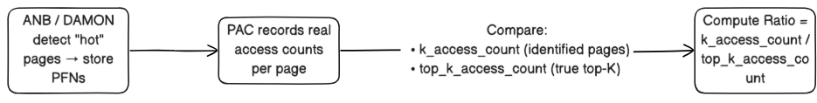
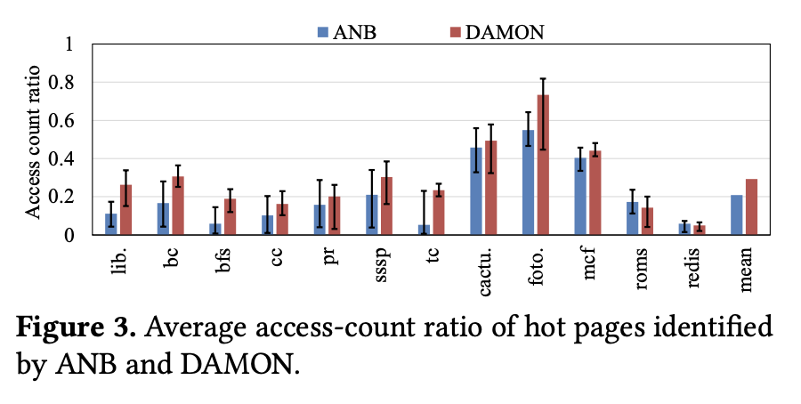
USEFULNESS OF IDENTIFIED HOT PAGES
Access Count
🟩 High ratio ⇒ Accurate identification 🟥 Low ratio ⇒ Warm pages mistaken as hot
Observations:
<0.4 on average → poor precision
DAMON slightly better than ANB
CPU-driven solutions often identify warm pages as hot pages.
Evaluate how accurately and efficiently CPU-driven page-migration solutions identify “hot” pages in memory using:
🔹 PAC (Page Access Counter): Measures the true number of accesses to each page.
🔹 WAC (Word Access Counter): Measures how many unique 64B words within a page are accessed (page sparsity).
🔹 ANB (Accessed-bit-based method): Detects hot pages by tracking accessed bits and soft page faults.
🔹 DAMON (Data Access Monitor): Identifies hot pages by sampling and scanning page table entries efficiently.

Slide 34
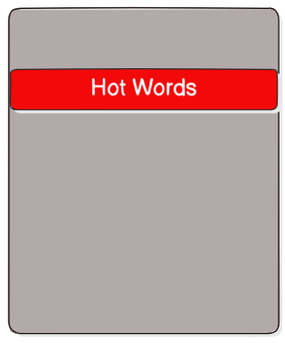
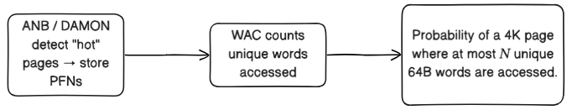
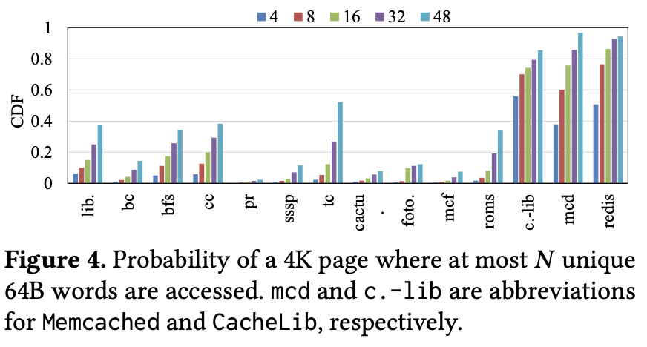
USEFULNESS OF IDENTIFIED HOT PAGES​
Access Count
Access sparsity
Sparse hot page wastes fast memory space & pollutes caches
🟩 High ratio ⇒ Accurate identification 🟥 Low ratio ⇒ Warm pages mistaken as hot
Observations:​
Many apps (e.g., Redis, Memcached) have sparse access patterns, so migrating full pages is inefficient.
​
Observations:
<0.4 on average → poor precision
DAMON slightly better than ANB
CPU-driven solutions often identify warm pages as hot pages.

Slide 35
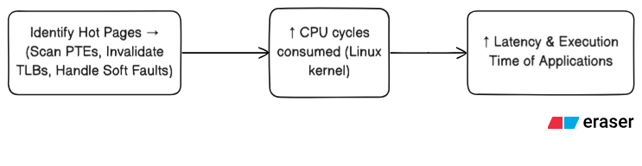
PERFORMANCE COST OF IDENTIFYING HOT PAGES
​
Access sparsity
Sparse hot page wastes fast memory space & pollutes caches
Metric | ANB | DAMON
↑ CPU cycles | +487% | +733%
Avg Overhead | +159% | +277%
Redis p99 Latency | +34% | +39%
App Time (SSSP/Liblinear) | +4.6% | +8.6%
Summary
Observations:​
Many apps (e.g., Redis, Memcached) have sparse access patterns, so migrating full pages is inefficient.
​
Aspect | Finding | Impact
Accuracy | Hot-page detection often wrong (warm pages) | Misguided migrations
Sparsity | Many pages partially used | Wasted fast memory
Overhead | Detection costly (up to +700% CPU cycles) | Hurts latency-sensitive apps

Slide 36
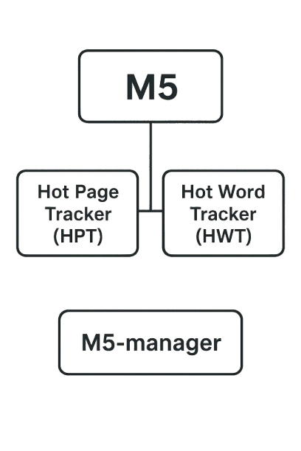
M5: TRACK, FILTER, AND MIGRATE

Slide 37
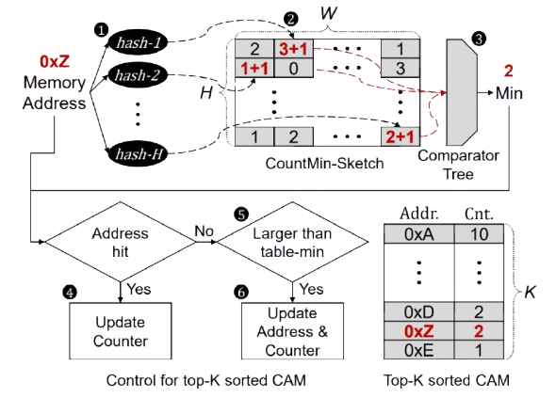
M5: TRACK, FILTER, AND MIGRATE
HPT and HWT
To make HPT and HWT useful and practical, we determine the following requirements: First, they should be able to handle each memory access every 2.5𝑛s. Second, when the host CPU queries the top-𝐾 hot addresses, it should be able to return them quickly. Lastly, the hardware cost should be reasonable, although it is a secondary constraint

Slide 38
HPT and HWT
To make HPT and HWT useful and practical, we determine the following requirements: First, they should be able to handle each memory access every 2.5𝑛s. Second, when the host CPU queries the top-𝐾 hot addresses, it should be able to return them quickly. Lastly, the hardware cost should be reasonable, although it is a secondary constraint
M5: TRACK, FILTER, AND MIGRATE

Slide 39
M5: TRACK, FILTER, AND MIGRATE
HPT and HWT
To make HPT and HWT useful and practical, we determine the following requirements: First, they should be able to handle each memory access every 2.5𝑛s. Second, when the host CPU queries the top-𝐾 hot addresses, it should be able to return them quickly. Lastly, the hardware cost should be reasonable, although it is a secondary constraint

Slide 40
M5: TRACK, FILTER, AND MIGRATE
HPT and HWT
To make HPT and HWT useful and practical, we determine the following requirements: First, they should be able to handle each memory access every 2.5𝑛s. Second, when the host CPU queries the top-𝐾 hot addresses, it should be able to return them quickly. Lastly, the hardware cost should be reasonable, although it is a secondary constraint

Slide 41
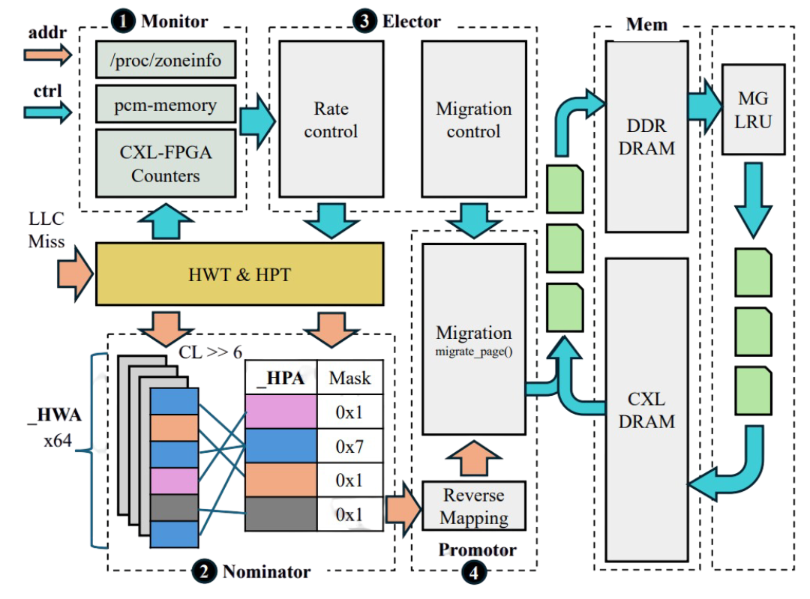
M5: TRACK, FILTER, AND MIGRATE
MONITOR
NOMINATOR
ELECTOR
PROMOTOR

Slide 42
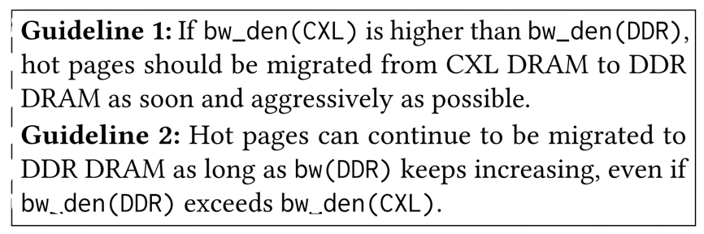

M5: TRACK, FILTER, AND MIGRATE
MONITOR
NOMINATOR
ELECTOR
PROMOTOR

Slide 43
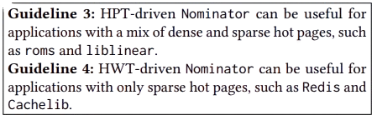
M5: TRACK, FILTER, AND MIGRATE
NOMINATOR
NOMINATOR
ELECTOR
PROMOTOR

Slide 44
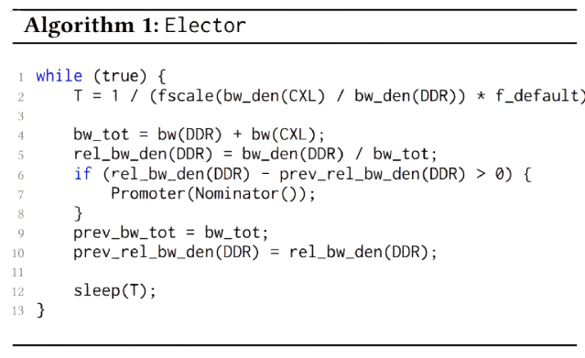
M5: TRACK, FILTER, AND MIGRATE
ELECTOR
NOMINATOR
ELECTOR
PROMOTOR

Slide 45
M5: TRACK, FILTER, AND MIGRATE
PROMOTOR
NOMINATOR
ELECTOR
PROMOTOR

Slide 46
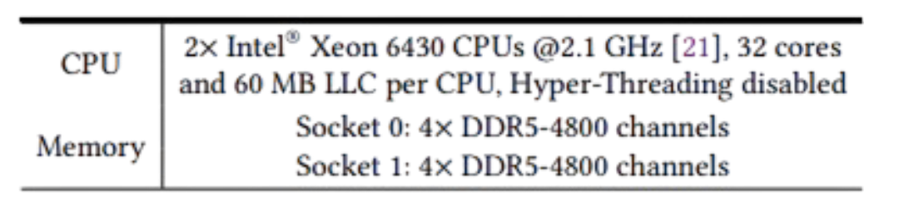
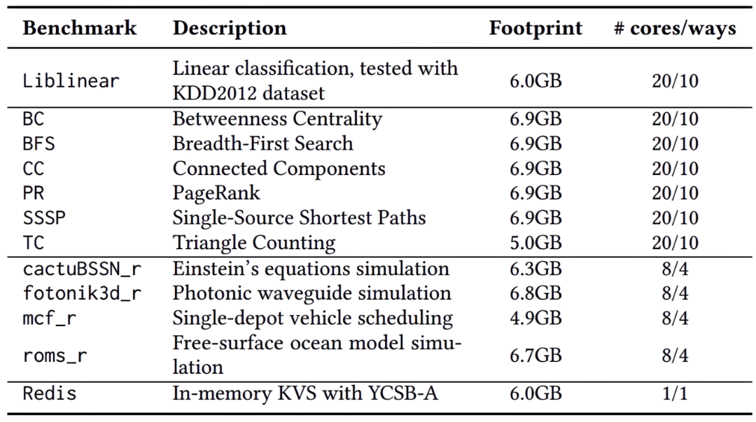
EVALUATION SETUP
SYSTEM
PAGE MIGRATION SOLUTIONS
For ANB, we use Linux version 5.19.
For DAMON we use Linux kernel version 6.11
M5 is implemented in Linux kernel version 6.5.
We decided not to port DAMON and ANB to the same kernel version as M5.
BENCHMARKS
Twelve memory-intensive benchmarks
As inputs, we use YCSB-A [11] (Redis), KDD 2012 [35] (Liblinear), Twitter [30] (BFS, CC, TC, and PR with undirected graph), and Google [1] (BC and SSSP with directed graph).
Adjusted the size of these input datasets to have a memory footprint close to 8GB.
Limited the capacity of DDR DRAM that a given benchmark can use to 3GB, ensuring that roughly 50% of the pages can be migrated to DDR DRAM.

Slide 47
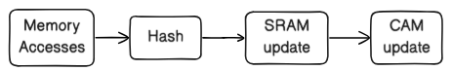
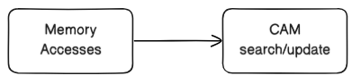
DETECTING HOT PAGES EFFICIENTLY
CM-Sketch vs. Space-Saving Top-K Tracker Designs
CM-Sketch Tracker
SRAM holds N access counts (large)
CAM holds top-K entries only → Small, scalable
Space-Saving Tracker
Sorted CAM with N entries (each stores address + access count) → Precise but large
CM-Sketch decouples counting and ranking → scales better under timing and area constraints.

Slide 48
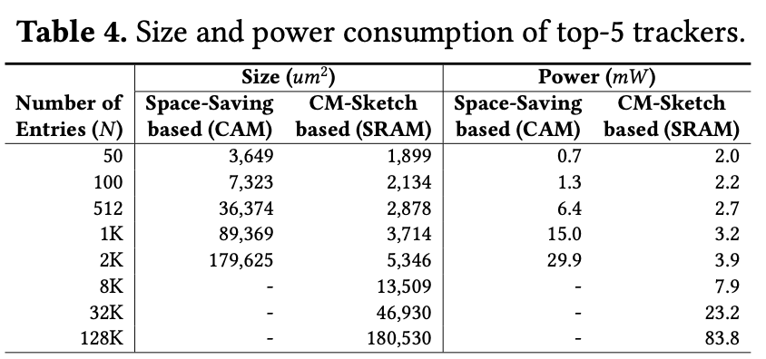
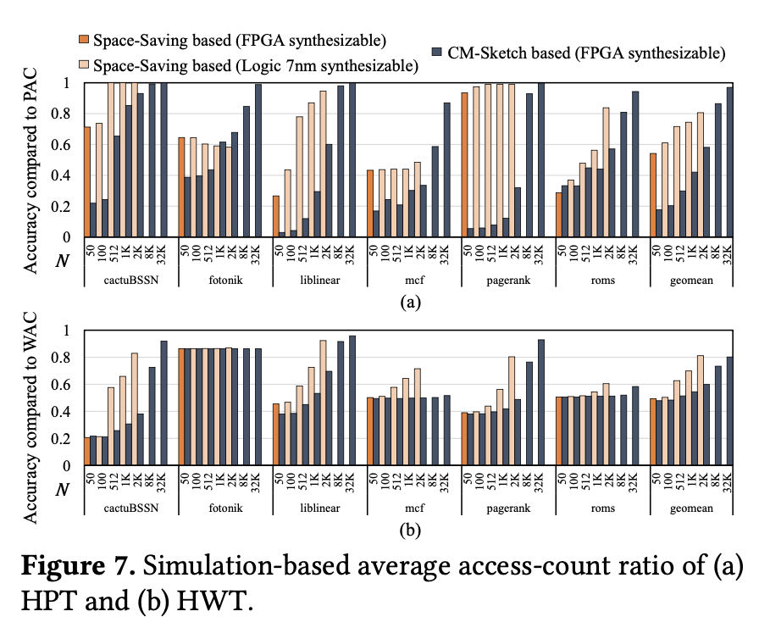
DESIGN EVALUATION: SIZE, POWER AND ACCURACY
“Accuracy ↑ with N”
“Space-Saving more precise for same N”
“But CM-Sketch allows much larger N ⇒ better practical accuracy (0.97 @ N=32K vs 0.49 @ N=50)”
Space-Saving = +33.6× area, +7.6× power vs CM-Sketch
CM-Sketch supports up to 128K entries @400MHz

Slide 49
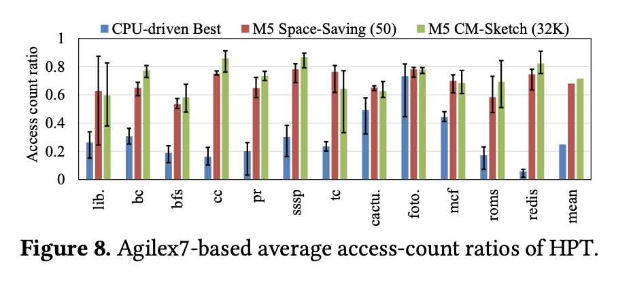
COMPARING HOT-PAGE DETECTION ACCURACY
CM-Sketch (32K): +3.5% vs Space-Saving, +47% vs CPU solutions
Avg. ratio = 0.72
Notes: “M5 may miss some globally-hot pages, but catches near-term hot pages effectively.”

Slide 50
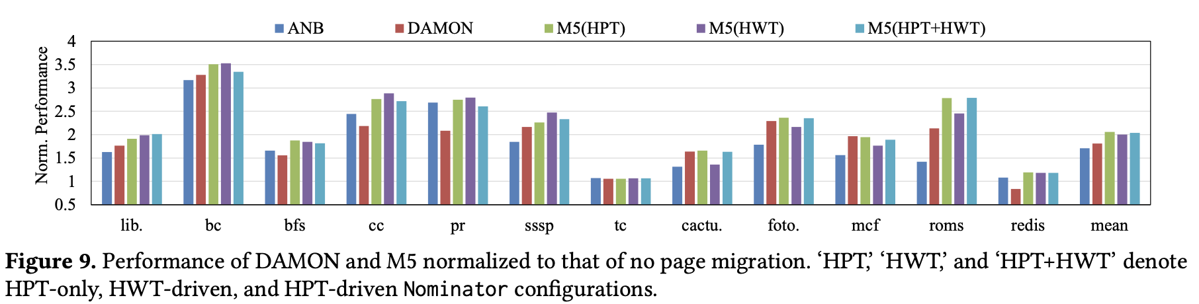
END-TO-END Performance of ANB, DAMON and M5
🧩 ANB → small boost (+8%)
🔍 DAMON → scans too long → slow (−16%)
⚙️ M5 → +14% vs DAMON, +106% vs baseline
Redis: M5 (HWT) → +43% vs DAMON
Liblinear / roms_r → big gains (due to skewed accesses)
M5 outperforms ANB & DAMON by detecting hotter pages faster and at lower overhead.

Slide 51
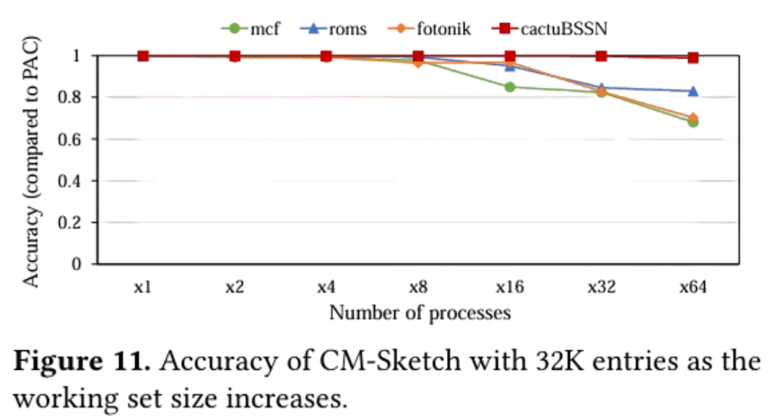
DISCUSSION

Slide 52
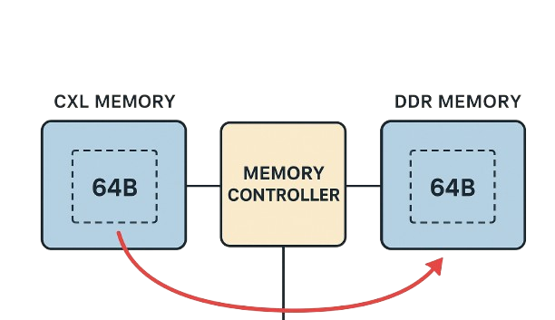
RELATED WORKS
Intel Flat Memory Mode (IFMM): When a CXL memory address is accessed, the memory controller swaps a 64B word at the CXL memory address with a 64B word at the one-to-one mapped DDR memory address. However, IFMM is limited to the case where local DDR memory and remote CXL memory have the same capacity because of the one-to-one mapping between CXL and DDR memory addresses for swapping.
NeoMem: Tracking hot pages in the CXL controller as concurrent work. However, in contrast to NeoMem, we also present PAC and WAC, which have enabled us to precisely evaluate the access-count ratio. Lastly, NeoMem does not track hot-word addresses, while M5 does.

Slide 53
CONCLUSION
First, this work proposed a CXL-driven, hardware-assisted profiling solution that leverages the unique capabilities of an FPGA-based CXL device.
Second, this work showed that CPU-driven page-migration solutions often not only classify warm pages as hot pages—many of which may also be sparse—but also incur notable performance overhead.
Lastly, this work presented M5, a platform for developing CXL-driven page-migration solutions.

Slide 54

THANK YOU

